Slide 1


Dungeons and cards
Ian Aguilar Ramírez
Daniel Méndez Sierra
David Muñoz Peña
Andrik Yahir Rosado

Slide 2
Assets

Slide 3
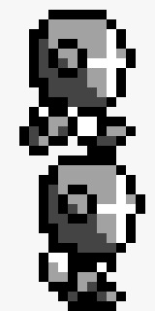
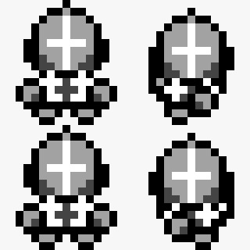
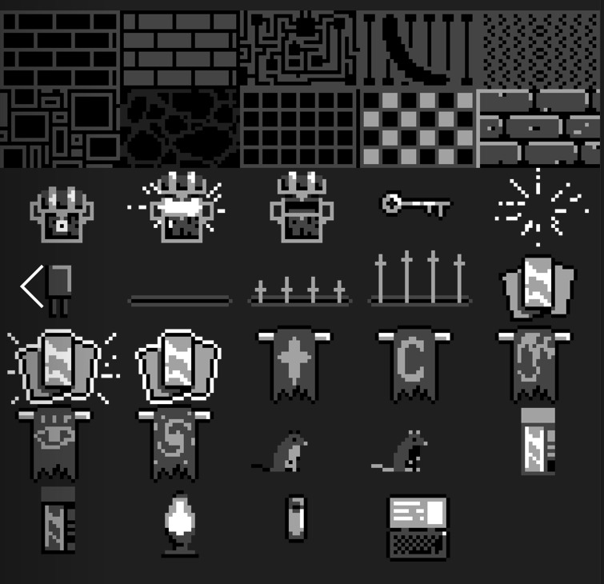

Slide 4
Class diagram

Slide 5
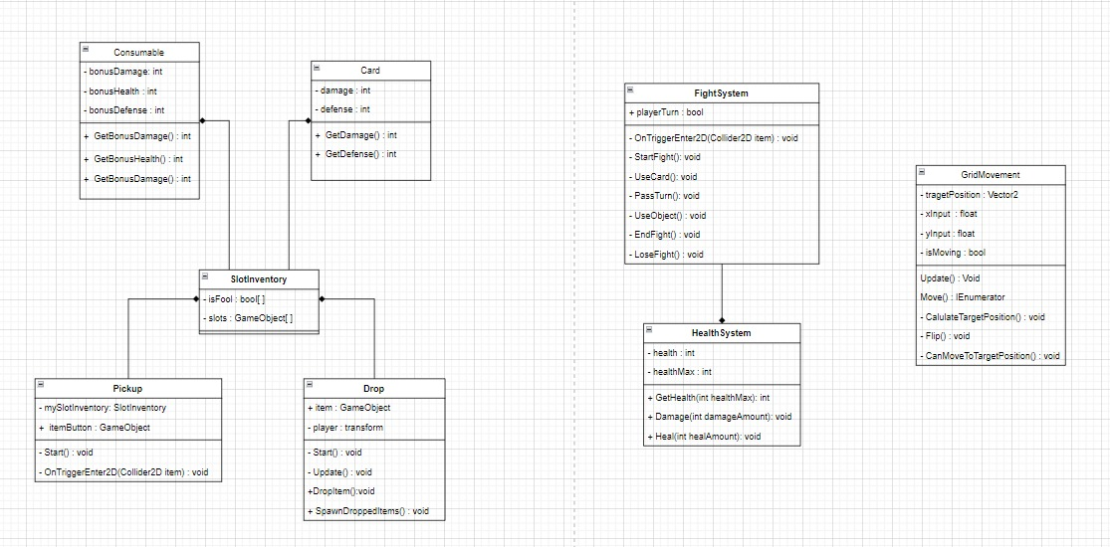

Slide 6
Contribution tracker

